Slide 1


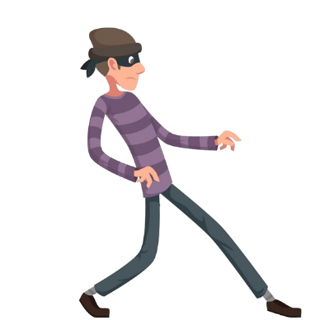

TAILGATING
RBC Fall Hackathon 2018 – Community #8

Slide 2
Summary
RBC has a wide variety of tools to cover most cyber threats; anti-virus and anti-spy software, firewalls, password refresh protocols and various campaigns to raise awareness of indirect attacks such as “phishing” and email Malware.
In big systems like RBC, employees often assume that their ‘risky’ actions or lack of actions (such as not reporting possible threat) will be covered by enterprise safety net. Most think that security and integrity of data is not their responsibly and that they have no control of information.
Tailgating is something that any employee can prevent, but most actually unknowingly promote it.

Slide 3
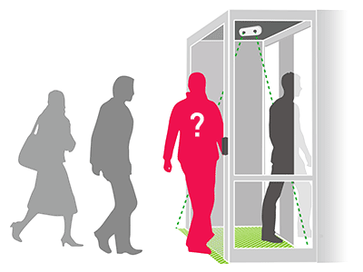
What is Tailgating?
Tailgating is a form of social engineering
Tailgating, also known as ‘piggybacking’ is when a person tags along with another person who is authorized to gain entry into a restricted area.
Even though in most cases it is not strictly ‘illegal’, it is almost always unauthorized.
Possible Information leak, danger to facility or employees and other low level threats.

Slide 4
Personas
RBC Employees
Full Time Employees
Co-Op and Interns
Contractors
Strongest Persona: Co-op students and Interns are most vulnerable to this type of ‘attack’; students tend to be more vulnerable, work heavily onsite, not aware of rules and protocols, scared to anger full time employees or managers, or simply want to be seen as approachable.
Note: Based on our research over 86% of co-ops failed to question the motives of anyone requesting the access to their floor/facility.

Slide 5
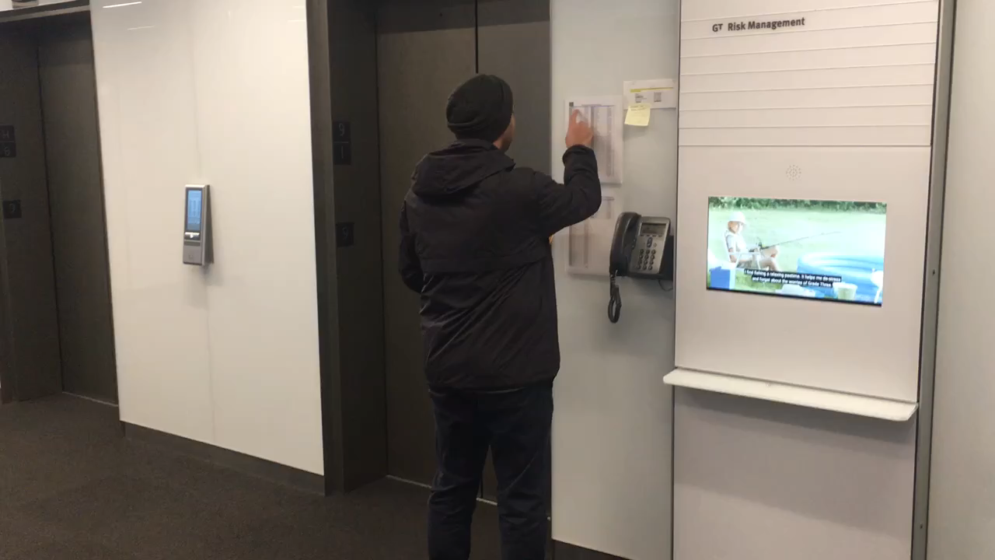
Video (Tailgating Exercise)

Slide 6
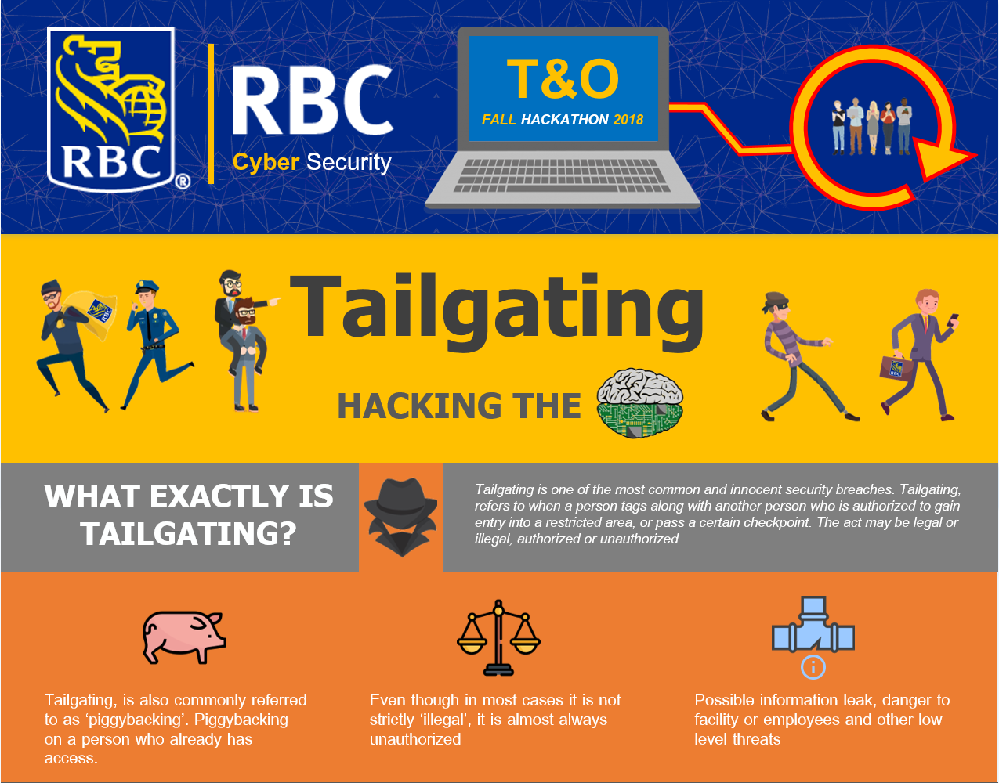
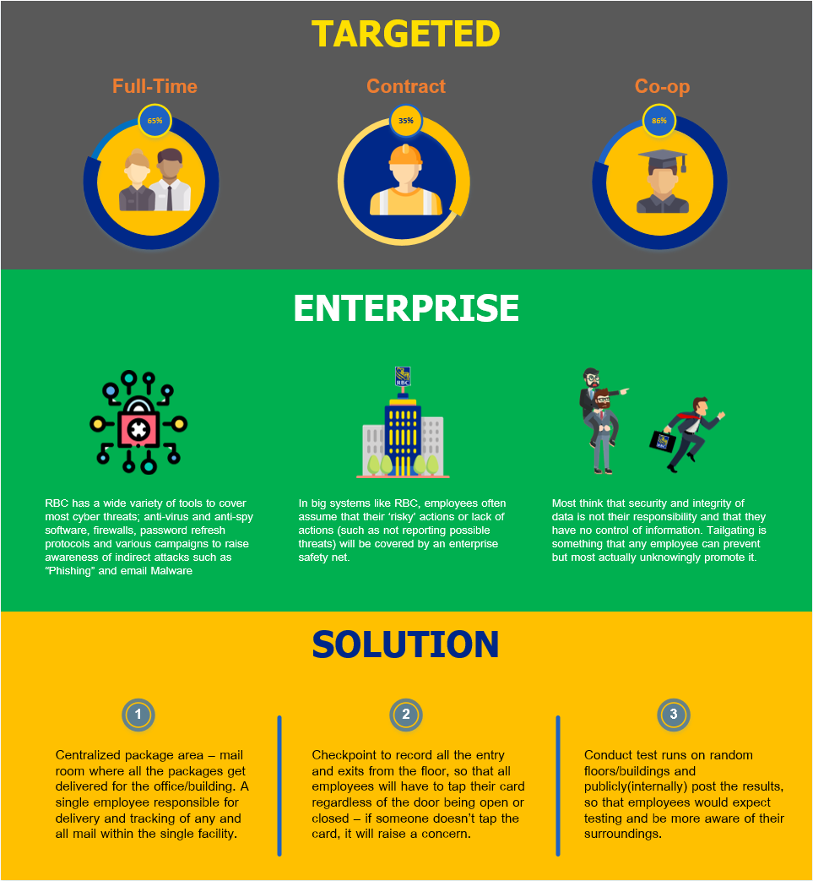
INFOGRAPHIC

Slide 7
Increasing Awareness
Quick exercise to raise awareness among employees
Have a person tailgate while holding a package
Hand package to targeted tailgated employee
Inside the package reads an awareness message: “This is a tailgating exercise, Please be mindful of suspicious packages”
A man-in-the-middle (MITM) attack can also be implemented in this approach
Once the tailgater has entered the building, they can locate an unmonitored laptop and further breach RBC’s network for confidential files

Slide 8
Proposed Solution
Centralized package area – mail room where all the packages get delivered for the office/building. A single employee responsible for delivery and tracking of any and all mail within the single facility.
Checkpoint to record all the entry and exits from the floor, so that all employees will have to tap their card regardless of the door being open or closed – if someone doesn’t tap the card, it will raise a concern.
Conduct test runs on random floors/buildings and publicly(internally) post the results, so that employees would expect testing and be more aware of their surroundings.

Slide 9
The End
Questions?

